Slide 1
PSCS_49_Al-based tool for preliminary diagnosis of Dermatological manifestations
CSE7101- Capstone Project
Review-1
Batch Number: 2022
Roll Number | Student Name
20221CAI0037 20221CAI0048 20221CAI0008 | Armaan Khan Syed Basim Shaik Mahammed Saif
Under the Supervision of,
Mr. Jai Kumar B
Assistant Professor
School of Computer Science and Engineering
Presidency University
Name of the Program: CAI-Computer Science & Engineering (Artificial Intelligence & Machine Learning)
Name of the HoD: Dr. Zafar Ali Khan N
Name of the Program Project Coordinator: Ms. Suma N G
Name of the School Project Coordinators: Dr. Sampath A K , Dr. Geetha A

Slide 2
Problem Statement Number:
Organization: MedTech/BioTech/HealthTech
Category (Hardware / Software / Both) :Software
Problem Description:
Dermatological disorders are highly prevalent and can affect individuals of all ages and backgrounds.
Accurate and timely diagnosis is crucial for effective treatment and the prevention of complications, such as progression to serious diseases like skin cancer.
There is often limited access to dermatology specialists, especially in rural or underserved communities, leading to long wait times and delays in diagnosis.
Healthcare systems are often overwhelmed, and dermatologists face high patient volumes, which can reduce the quality and consistency of care.
The diagnostic process for skin conditions relies on visual assessment, resulting in variability based on clinician experience and increasing the risk of misdiagnosis.
Many patients resort to self-diagnosis using unreliable sources, causing confusion, anxiety, or delays in seeking appropriate medical attention.
There is a growing need for an accessible and efficient preliminary diagnostic tool to support both patients and healthcare providers in the early assessment and triage of skin manifestations.
An AI-based tool can provide instant, consistent, and data-driven preliminary analysis, improving access to care, standardization of diagnosis, and overall patient outcomes.

Slide 3
Content
Objectives
Develop an easy-to-use AI tool that can analyze images of skin conditions quickly and accurately.
Help users get a preliminary diagnosis of various dermatological issues without needing immediate doctor visits.
Improve early detection of serious skin diseases like melanoma to enable timely treatment.
Support doctors by providing a reliable screening tool to prioritize urgent cases.
Make dermatological care more accessible, especially for people in remote or underserved areas.
Reduce the workload on dermatologists by filtering non-urgent cases.
Ensure the tool is secure and protects patient privacy.
Continuously improve the AI’s accuracy by learning from new data and cases.

Slide 4
Content (continuation)..
Background and Related work for title Selection
Background
Skin diseases affect millions worldwide, ranging from minor to serious conditions.
Early and accurate diagnosis is essential for effective treatment and prevention of complications.
Traditional diagnosis depends on dermatologist availability and clinical expertise.
There is limited access to dermatologists, especially in remote and underserved areas.
Advances in AI and image recognition have created new opportunities for automated diagnosis.
Related Work
AI models using deep learning, especially CNNs, can analyze skin images for diagnosis.
Some AI tools have matched or surpassed dermatologist accuracy in detecting conditions like melanoma.
Existing tools mostly support clinicians or telemedicine but face challenges like data bias and image quality.
Research aims to improve accuracy, disease coverage, and user-friendliness of these AI tools.
This project builds on previous work to develop an accessible tool for preliminary diagnosis that helps patients and doctors.

Slide 5
Analysis of Problem Statement
Technology Stack Components
Frontend:
  web application for image upload and user interface
  Technologies: React Native, Flutter
Backend:
  Server to handle requests, process images, and communicate with AI models
  Technologies: Node.js, Python (Django, Flask),
  AI and Machine Learning:
  Deep Learning frameworks for model development and training
  Technologies: TensorFlow, PyTorch, Keras
  Pretrained convolutional neural networks (CNNs) tailored for dermatology image classification
Image Processing:
  Tools for image preprocessing (resizing, normalization, quality enhancement)
  Libraries: OpenCV, PIL (Python Imaging Library)

Slide 6
Github Link
The Github link provided should have public access permission.
Github Link
https://github.com/thesyedbasim/CAI-15-Al-based-tool-for-preliminary-diagnosis-of-Dermatological-manifestations.git

Slide 7
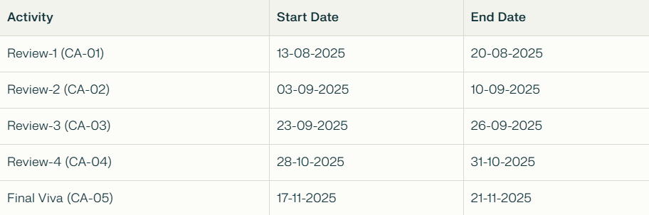
Timeline of the Project (Gantt Chart)

Slide 8
References (IEEE Paper format)
[1] Sánchez-Montalvá, M.P., et al. (2024). "A systematic review and meta-analysis of artificial intelligence algorithms for skin cancer classification." Nature Digital Medicine, 11, 103.
[2] Nature Scientific Reports (2025). "Skin cancer detection using dermoscopic images with convolutional neural networks." Scientific Reports, March 2025.
[3] Detection of Skin Cancer Based on Skin Lesion Images Using Deep Learning (2022). PMC Article, PMC9324455, June 24, 2022.

Slide 9
PSCS_49_Al-based tool for preliminary diagnosis of Dermatological manifestations
CSE7101- Capstone Project
Review-2
Batch Number: 2022
Roll Number | Student Name
20221CAI0037 20221CAI0048 20221CAI0008 | Armaan Khan Syed Basim Shaik Mahammed Saif
Under the Supervision of,
Mr. Jai Kumar B
Assistant Professor
School of Computer Science and Engineering
Presidency University
Name of the Program: CAI-Computer Science & Engineering (Artificial Intelligence & Machine Learning)
Name of the HoD: Dr. Zafar Ali Khan N
Name of the Program Project Coordinator: Ms. Suma N G
Name of the School Project Coordinators: Dr. Sampath A K , Dr. Geetha A

Slide 10
Abstract
Skin diseases are among the most common health issues worldwide, but timely diagnosis is often limited due to shortage of dermatologists and lack of access to specialized care. This project proposes an AI-based tool that enables preliminary diagnosis of dermatological manifestations using deep learning models trained on dermatoscopic and clinical skin images. The system assists patients and healthcare workers by identifying possible conditions and providing recommendations for further consultation. The approach integrates Convolutional Neural Networks (CNNs), transfer learning, and explainable AI techniques, ensuring robust classification and interpretable predictions. This solution aims to provide low-cost, accessible, and scalable healthcare support in dermatology.

Slide 11
Literature Survey (10 Papers Reviewed)
Artificial Intelligence in Skin Cancer Diagnosis: A Reality Check (2023)
Skin cancer detection using deep machine learning techniques (2024)
AI-Powered Diagnosis of Skin Cancer: A Contemporary Review, Open Challenges and Future Research Directions (2023)
Review on Automated Skin Cancer Detection Using Image Processing Techniques(2023)
Enhanced skin cancer diagnosis: a deep feature extraction-based framework for the multi-classification of skin cancer utilizing dermoscopy images (2024)
Artificial intelligence for skin cancer detection and classification for clinical environment: a systematic review(2024)
Detection of Skin Cancer Based on Skin Lesion Images Using Deep Learning(2022)
Skin cancer detection using multi-scale deep learning and transfer learning(2023)
A precise model for skin cancer diagnosis using hybrid U‑Net and improved MobileNet‑V3 with hyperparameters optimization(2024)
Boosting skin cancer diagnosis accuracy with ensemble approach(2025)
A robust deep learning framework for multiclass skin cancer classification(2025)

Slide 12
Objectives
1. Develop Deep Learning-Based Tool
  Build a reliable AI model for accurate skin disease classification.
  Achieve dermatologist-level performance using CNN/Transformer models.
2. Enable Preliminary Diagnosis
  Support multi-class & multi-label classification.
  Assist in identifying conditions requiring urgent medical care.
3. Ensure Scalability Across Skin Tones
  Train with diverse datasets (age, ethnicity, lighting).
  Adaptable to new datasets for real-world usage.
4. Integrate Explainable AI
  Use Grad-CAM, LIME, SHAP for visual explanations.
  Improve trust, transparency, and clinical acceptance.
5. Provide User-Friendly Interfaces
  Web portal for doctors & mobile app for patients.
  Features: image upload, instant results, explanations, secure sharing.

Slide 13
Existing Methods and Drawbacks
1. Traditional Image Processing
Method: Manual feature extraction (texture, color, shape).
Drawback: Limited accuracy, high dependency on handcrafted features.
2. CNN-based Models (ResNet, EfficientNet, Inception)
  Method: Deep convolutional networks trained on dermatology datasets.
  Strength: High accuracy for disease classification.
  Drawback: Require very large and diverse labeled datasets to generalize well.
3. Federated Learning Models
  Method: Distributed training across multiple devices/institutions without data sharing.
  Strength: Protects patient privacy and enables multi-institutional learning.
  Drawback: Computationally heavy and difficult to implement in real-world clinical settings.
  General Limitations
  Lack of Generalizability: Models trained on specific datasets may not work across demographics, skin tones, or environments.
  Data Dependency: Success depends heavily on large labeled datasets, which are costly and time-consuming to curate.

Slide 14
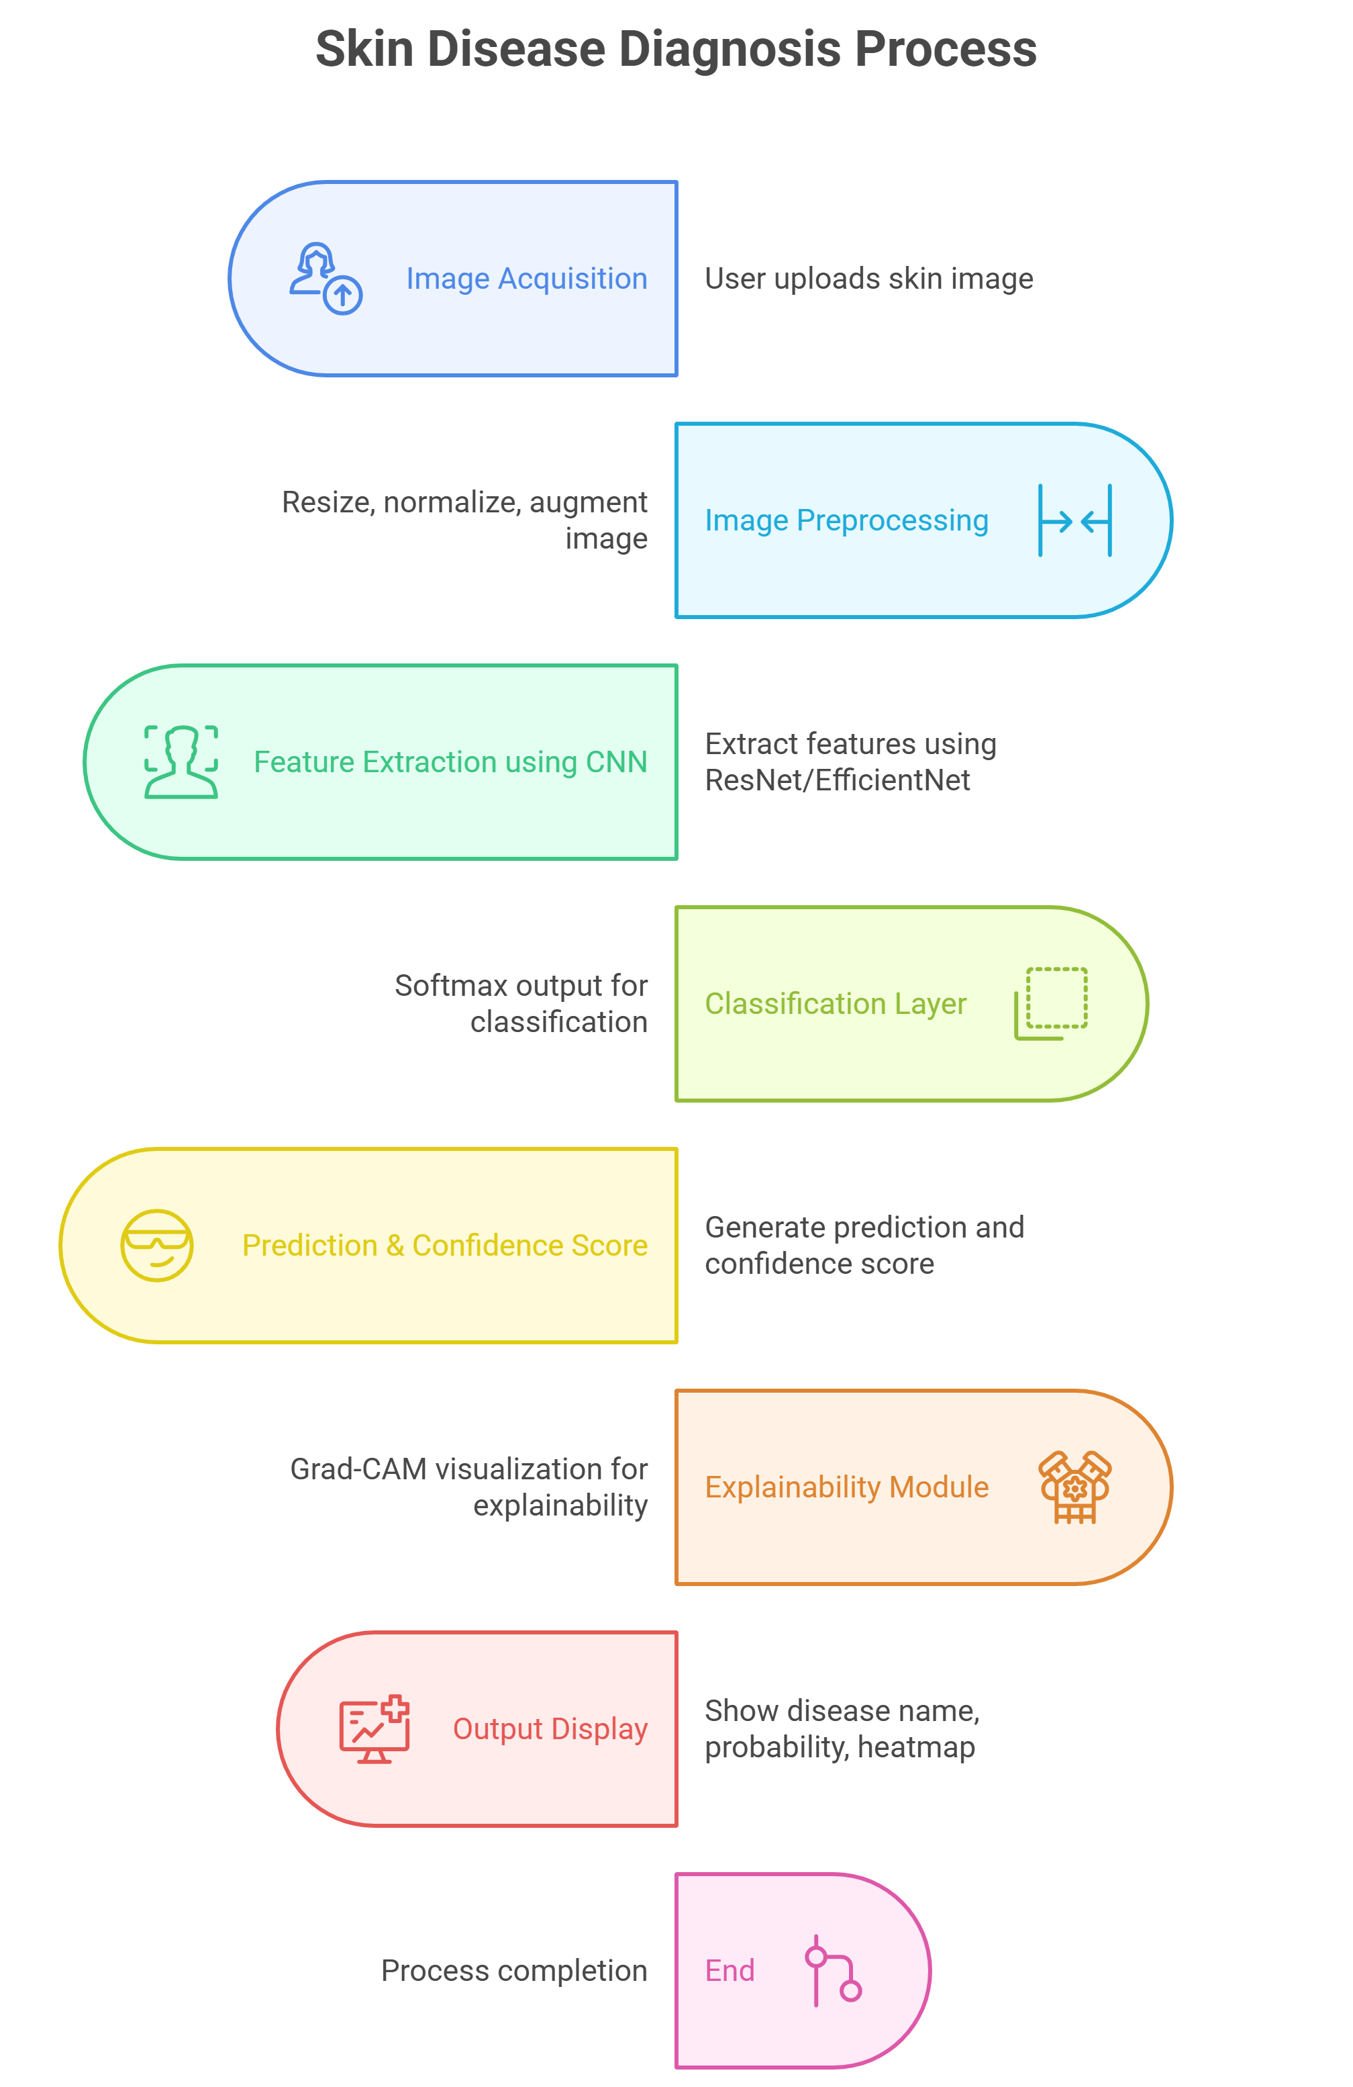
Architecture Diagram
.

Slide 15
References
1. Artificial Intelligence in Skin Cancer Diagnosis: A Reality Check Gabriella Brancaccio1 , Anna Balato1 , Josep Malvehy2,3 , Susana Puig2,3 , Giuseppe Argenziano1 and Harald Kittler4
2. Skin cancer detection using deep machine learning techniques Olusoji Akinrinade * , Chunglin Du
3. AI-Powered Diagnosis of Skin Cancer: A Contemporary Review, Open Challenges and Future Research Directions
4. Review on Automated Skin Cancer Detection Using Image Processing Techniques Haniye Jafari1 , Mojtaba Esmailpour Roshan2
5. Enhanced skin cancer diagnosis: a deep feature extraction-based framework for the multi-classification of skin cancer utilizing dermoscopy images
6. Artificial intelligence for skin cancer detection and classification for clinical environment: a systematic review
7. Detection of Skin Cancer Based on Skin Lesion Images Using Deep Learning Walaa Gouda 1,2,* , Najm Us Sama 3 , Ghada Al-Waakid 4 , Mamoona Humayun 5,* and Noor Zaman Jhanjhi 6
8. Skin cancer detection using multi-scale deep learning and transfer learning
9. A precise model for skin cancer diagnosis using hybrid U‑Net and improved MobileNet‑V3 with hyperparameters optimization
10. Boosting skin cancer diagnosis accuracy with ensemble approach
11. A robust deep learning framework for multiclass skin cancer classification

Slide 16
PSCS_49_Al-based tool for preliminary diagnosis of Dermatological manifestations
CSE7101- Capstone Project
Review-3
Batch Number: 2022
Roll Number | Student Name
20221CAI0037 20221CAI0048 20221CAI0008 | Armaan Khan Syed Basim Shaik Mahammed Saif
Under the Supervision of,
Mr. Jai Kumar B
Assistant Professor
School of Computer Science and Engineering
Presidency University
Name of the Program: CAI-Computer Science & Engineering (Artificial Intelligence & Machine Learning)
Name of the HoD: Dr. Zafar Ali Khan N
Name of the Program Project Coordinator: Ms. Suma N G
Name of the School Project Coordinators: Dr. Sampath A K , Dr. Geetha A

Slide 17
Architecture Diagram
Flowchart:

Slide 18
Proposed approach
The core goal of the given project is to design and implement an AI-based diagnostic support system that will be able to offer a preliminary evaluation of dermatological manifestations based on dermoscopic images and other key clinical metadata. The system is geared towards helping the healthcare professionals, more so those who are in a resource-constrained setting by providing prompt, precise and interpretable diagnostic information. The combination of state-of-art deep learning application with explainable AI and metadata integration are expected to increase the rates of early detection, a decrease in diagnostic waiting time and ease of access to dermatological services among rural and semi-urban areas of operation.

Slide 19
EfficientNetB4 Feature Extractor. The central part of the model is based on the EfficientNetB4 architecture that offers better performance in medical image classification because it offers balanced scaling of convolutional layers. The trained model, which was pretrained using ImageNet weights, produces fine lesion features which include pigment networks, asymmetry, vascularity, and edges. Metadata Processing Network The model includes the necessary patient metadata such as age, sex and anatomical location, all of which are clinically important in diagnosis. Age is normalized, and categorical variables (sex and location of the lesion) are one-hot encoded. These characteristics undergo fully connected layers to produce meaningful embeddings. Feature Fusion Layer An embedding of the image feature is combined with the metadata to produce a more comprehensive diagnostic representation. The hybridization enables the system to imitate the real-world dermatologist decision-making in which the diagnosis is made based not only on the visual feature of the patient but also on their context. Class Management with Class Skewing. The HAM10000 data is not balanced as it has some lesions that are not fully represented. Class weights are also computed and used in training the model to address the problem of biasness against classes that are of majority. Grad-CAM Explainability in AI.

Slide 20
Objectives
The objectives of this project will be designed to meet the behavioural, analytical, managerial, security and deployment needs of an AI-aided dermatological diagnostic system. These goals guarantee that the system is reliable, efficient in data processing, the system is trusted by the users, and can be deployed in the real field of healthcare. All the objectives can be measured and directly implemented in the system architecture and implementation.
Objective 1: As a part of designing and implementing a multimodal deep learning model, it is possible to analyse the dermoscopic image behaviour and extract clinically meaningful patterns. This goal is aimed at the behavioural component of the system and the possibility to detect and memorize the complex visual features of the skin lesion. The deep learning model should be able to detect pigment networks, asymmetry, lesion edges, vascular architecture, and texture differences that can be related to various dermatological diseases. The system is able to learnbehavioural cues such as observed by dermatologists by using EfficientNetB4 and other sophisticated convolutional operations, thereby guaranteeing the relevance and the accuracy of its diagnostics.

Slide 21
Objective 2: To create an analytical metadata fusion system that incorporates age, sex, and anatomical site with image-based characteristics in order to make a better diagnosis decision. The diagnostic process in dermatology cannot be entirely based on images, and the doctor usually uses demographics, and localization of the lesion to assess it correctly. This goal will provide the system with an analytical processing of metadata based on organized layers and fuses it with profound visual features via a fusion architecture. Clinical context integration enhances more dependable decision-making, and it reflects the actual diagnostic process, which enhances sensitivity and specificity between lesion types
Objective 3: To implement a model management workflow through systematic model where dataset is preprocessed, weights of classes are considered, performance is being monitored, and optimization is being done in an iterative manner to achieve a biased-free training. An effective diagnostic system must have a robust data and model behaviour that is internally managed. This goal presents an organized dataset balancing, normalization, augmentation, and partitioning workflow. The model is fair and it reduces bias in the classes of majority, which is achieved through class-weighting schemes and continuous training observation. This is to make sure that minor forms of lesions like dermatofibroma or vascular lesions are well reflected in the training and help in achieving a balanced assessment.

Slide 22
PSCS_49_Al-based tool for preliminary diagnosis of Dermatological manifestations
CSE7101- Capstone Project
Review-4
Batch Number: 2022
Roll Number | Student Name
20221CAI0037 20221CAI0048 20221CAI0008 | Armaan Khan Syed Basim Shaik Mahammed Saif
Under the Supervision of,
Mr. Jai Kumar B
Assistant Professor
School of Computer Science and Engineering
Presidency University
Name of the Program: CAI-Computer Science & Engineering (Artificial Intelligence & Machine Learning)
Name of the HoD: Dr. Zafar Ali Khan N
Name of the Program Project Coordinator: Ms. Suma N G
Name of the School Project Coordinators: Dr. Sampath A K , Dr. Geetha A

Slide 23
Analysis and Design
Introduction
Analysis and Design stage brings in the structural and functional outline of the artificial intelligence-based dermatology diagnosis system. The step is aimed at getting familiar with the problem space, determining the requirements of the system and defining a modular architecture that would aid in analysing the images, processing metadata, explainability and interaction with users. The ultimate objective involves the development of a robust and scalable system that has a high accuracy in classifying skin lesions and does not suffer in usability, reliability, and clinical relevance. Its design incorporates many elements, among them, preprocessing pipelines, machine learning modules, fusion layers, explainability mechanisms, and a web-based interface. A methodical process will guarantee that every module has significant input to the general procedure of work, and the system will be efficient and give precise and operable forecast

Slide 24
System Analysis
System analysis assists to decompose the problem into manageable parts and it also indicates what the system should accomplish. The conventional method of dermatological diagnosis presupposes the professional evaluation of the dermatologist, yet the insufficiency of the dermatology supply poses a significant disparity in the diagnosis at an early stage. Therefore, the system must: Give AI-based preliminary skin lesion classification. Image + metadata Support Multimodal input (image + metadata). Provide timely and precise predictions. Provide visual explanations of offers. Be consistent in a variety of image conditions. Work within resource limitations that are deployable.

Slide 25
Functional Requirements
Functional requirements are statements of how the system is supposed to behave. Image Input Handling The user should be able to post dermoscopic images of supported formats (JPEG/PNG). Image quality verification should come before processing in the system. Metadata Collection Tolerate patient information such as age, sex and location of lesion. Model metadata and encode so that they can be processed by models. Preprocessing and Augmentation Preprocessing and Augmentation Preprocessing

Slide 26
PSCS_49_Al-based tool for preliminary diagnosis of Dermatological manifestations
CSE7101- Capstone Project
Review-5
Batch Number: 2022
Roll Number | Student Name
20221CAI0037 20221CAI0048 20221CAI0008 | Armaan Khan Syed Basim Shaik Mahammed Saif
Under the Supervision of,
Mr. Jai Kumar B
Assistant Professor
School of Computer Science and Engineering
Presidency University
Name of the Program: CAI-Computer Science & Engineering (Artificial Intelligence & Machine Learning)
Name of the HoD: Dr. Zafar Ali Khan N
Name of the Program Project Coordinator: Ms. Suma N G
Name of the School Project Coordinators: Dr. Sampath A K , Dr. Geetha A

Slide 27
Implementation
System Overview
The implementation phase was concerned with turning the suggested architecture into a fullfledged, end-to-end AI system that would be able to process dermoscopic images, incorporate clinical metadata, make predictions, and display diagnostic heatmaps. The system is multimodal with images and metadata branches running separately and their features being integrated at a later stage. The implementation was done in a modular manner whereby every subsystem, preprocessing, model training, evaluation, inference pipeline and UI deployment, can be updated without toying up the whole system. The entire pipeline consists of: Preprocessing and augmentation of images. Encoding and normalization of metadata. Feature extraction based on EfficientNetB4. Combined representation Fusion network. Head of classification of seven skin lesions. Grad-CAM explainability module. Front-end Web-based and Flask-based back-end. This modularity guarantees maintainability, future scalability and future upgradeability

Slide 28
Evaluation and Results
In order to guarantee that the AI-based dermatology diagnosis system is effective in a variety of conditions, a set of test points was introduced in a structured form. These test points are aimed at testing the technical accuracy of the model and the possibility to apply it in diagnostic real-life conditions. The main areas that were chosen as evaluation checkpoints are: Image Quality Sensitivity: To test the system concerning its response to varying quality of input, the system was tested using images with different resolutions, varying lighting conditions, and varying levels of noise.
Performance in Detection by Class: They determined test points to establish the discrimination of the model to the seven types of lesions of HAM10000 such as melanoma, benign keratosis, and basal cell carcinoma, which tend to be visually alike

Slide 29
Metadata Contribution: The success of age, sex and site of anatomy integration was tested to make certain that metadata integration enhances predictive accuracy rather than bias. Model Robustness and Stability: Validation curves and training curves were observed keenly to identify unstable behavior of learning or overfitting. A qualitative test point that was also utilized to demonstrate that the model concentrates on clinically significant areas of lesion is Grad-CAM heatmaps. User Interaction and the Clarity of the Output: The interface of the tool was evaluated in terms of the clear prediction labels, confidence scores, and heatmap overlays to make sure that the nonexpert users will be able to read the results correctly.All these test points assisted in justifying both the accuracy of the algorithm and the feasibility and interpretability of the system.

Slide 30
Test Result
The system had good performance in all the measurement metrics. The major findings include: High Overall Accuracy: The model had a accuracy of 92.5 which means that it is consistent in classifying different types of lesions. Balanced Precision and recall: Precision (91.2) and recall (90.8) are used to show the model capability to recognize both malignant and benign lesions without over-predicting any of the categories. F1-Score and ROC-AUC: The F1-score of 91.0% indicates that excellent results are achieved in situations when the false positives and false negatives should be reduced. The scores of the ROC-AUC at the classes, as can be seen in the evaluation plots, reveal that there is always strong discrimination ability of all the seven lesion categories

Slide 31
References
1. Sandhiya Devi M, Shanjanasree P, Sona S, Ms. Swetha, “AI Based Tool for Preliminary Diagnosis of Dermatological Manifestations,” May 2025. 2. Ling-Fang Li, Xu Wang, Wei-Jian Hu, Neal N. Xiong, Yong-Xing Du, Bao-Shan Li, “Deep Learning in Skin Disease Image Recognition,” 2020-11-01. 3. Nourah Janbi, Rashid Mehmood, Iyad Katib, Aiiad Albeshri, Juan M. Corchado, Tan Yigitcanlar, “Imtidad: A Reference Architecture and a Case Study on Developing Distributed AI Services for Skin Disease Diagnosis over Cloud, Fog and Edge,” 2022. 4. Zhouxiao Li, Konstantin Christoph Koban, Thilo Ludwig Schenck, Riccardo Enzo Giunta, Qingfeng Li, Yangbai Sun, “Artificial Intelligence in Dermatology Image …” (incomplete title). 5. Prof. S.R. Kale, Mr. Mahesh Dandekar, Mr. Mahesh Bawane, Mr. Parth Dangre, Mr. Parth Sabale, “AI Based Tool for Preliminary Diagnosis of Dermatological Manifestations,” 2025-04-01. 6. Yali Nie, Paolo Sommella, Marco Carratù, Matteo Ferro, Mattias O’Nils, Jan Lundgren, “Recent Advances in Diagnosis of Skin Lesions …” (incomplete title). 7. Prof. S.R. Kale, Parth V. Sable, Parth S. Dangre, Mahesh R. Dandeker, Mahesh Bawane, “A Review on AI-Based Tool for Preliminary Diagnosis of Dermatological Manifestations,” Jan–Feb 2025. 8. Rashmi N. Kuppast, Preetham R., K. Chandan, Chethan K., “AI Tool for Preliminary Diagnosis of Dermatology Manifestation,” IJARIIE Journal, Vol-10, Issue-3, 2024. 9. Dr. Chandrasekar Vadivelraju, Keren Elisheba S, Vikhyath Moodbidri, Bharath Kumar, Pavaman Suraj, Merugu Harish Reddy, “Dermascan AI: Deep Learning System for Preliminary Diagnosis of Dermatological Manifestations,” Volume 13, Issue 5, May 2025. 10. Zhouxiao Li, Konstantin Christoph Koban, Thilo Ludwig Schenck, Riccardo Enzo Giunta, Qingfeng Li, Yangbai Sun, “Artificial Intelligence in Dermato …” (duplicate/incomplete title).

Slide 32
11. Prof. S.R. Kale, Parth V. Sable, Parth S. Dangre, Mahesh R. Dandeker, Mahesh Bawane, “A Review on AI-Based Tool for Preliminary Diagnosis of Dermatological Manifestations,” 2025. (duplicate entry) 12. Yali Nie, Paolo Sommella, Marco Carratù, Matteo Ferro, Mattias O’Nils, Jan Lundgren, “Recent Advances in Diagnosis of Skin Lesions Using Dermoscopic Images Based on Deep Learning,” 2022-08- 17. 13. Esteva A., et al., “Dermatologist-level Classification of Skin Cancer with Deep Neural Networks,” Nature, 2017. 14. Codella N., et al., “Skin Lesion Analysis Toward Melanoma Detection,” ISBI, 2018. 15. Brinker T.J., et al., “Deep Learning Outperformed 136 of 157 Dermatologists in a Head-to-Head Dermoscopic Melanoma Image Classification Task,” Eur J Cancer, 2019.

Slide 33
16. Bucaioni, A., Weyssow, M., He, J., Lyu, Y., Lo, D., “Artificial Intelligence for Software Architecture: Literature Review and the Road Ahead,” arXiv:2504.04334, 2025. 17. Devanshu Agarwal, Dr. Vishal Shrivastava, Dr. Akhil Pandey, Dr. Karuna Sharma, Dr. Ashok Kumar Kajla, “Building Scalable Web Applications with Python,” IJRPR Volume 6, Issue 5, May 2025, pp. 6591–6597. 18. Es, S., James, J., Anke, L.E., Schockaert, S., “RAGAS: Automated Evaluation of Retrieval Augmented Generation,” EACL System Demonstrations, March 2024. 19. Niu, C., Wu, Y., Zhu, J., Xu, S., Shum, K., Zhong, R., Song, J., Zhang, T., “Ragtruth: A Hallucination Corpus for Developing Trustworthy Retrieval-Augmented Language Models,” ACL 2024. 20. Ahmad, S., Nezami, Z., Hafeez, M., Zaidi, S.A.R., “Benchmarking Vector, Graph and Hybrid RAG Pipelines for Open RAN,” arXiv:2507.03608, 2025.

Slide 34
20. Ahmad, S., Nezami, Z., Hafeez, M., Zaidi, S.A.R., “Benchmarking Vector, Graph and Hybrid RAG Pipelines for Open RAN,” arXiv:2507.03608, 2025. 21. Krishna, S., Krishna, K., Mohananey, A., Schwarcz, S., Stambler, A., Upadhyay, S., Faruqui, M., “Fact, Fetch, and Reason: A Unified Evaluation of Retrieval-Augmented Generation,” NAACL-HLT 2025. 22. Barnett, S., Kurniawan, S., Thudumu, S., Brannelly, Z., Abdelrazek, M., “Seven Failure Points When Engineering a Retrieval-Augmented Generation System,” AI Engineering Conference, April 2024. 23. Young A.T., et al., “Stress Testing Reveals Gaps in Clinic Readiness of Image-Based Diagnostic AI Models,” NPJ Digital Medicine, 2021. 24. Daneshjou R., et al., “Lack of Transparency and Potential Bias in Artificial Intelligence Data Sets and Algorithms,” JAMA Dermatology, 2021. 25. Adamson A.S., et al., “Machine Learning and Health Care Disparities in Dermatology,” JAMA Dermatol, 2018.

Slide 35


